Slide 1

History of Maths
HISTORY OF MATHEMATICS · MTH6003U
SCAN FOR THE BOOKLET
Our summer research project — what we have learnt
Historical Contributions of Different Cultures to Mathematics
QMUL, 2024–2026 · seresearch.qmul.ac.uk
Ivelina Mladenova · Norberto Lucero Azuara
Queen Mary University of London · 13 October 2026
Notes:
0:00–2:00 [Ivelina]. Welcome. Ask students to scan the QR code now: it opens our booklet, "Historical Contributions of Different Cultures to Mathematics" (QMUL, 2024–2026), at https://www.seresearch.qmul.ac.uk/content/pce/schoolsedi/files/History_of_Maths_QMUL_2026.pdf — also post this link on the module page. Chapter 6 (calculus) and Chapter 7 (Bayesian probability) are the worked examples we return to near the end. This lecture summarises our summer research project. Plan: Section 1, eight rules for reading the history of mathematics; Section 2, real cases where the rules were broken; Section 3, writing carefully and the careful-sentence game; Section 4, where to start reading and where the originals live; Section 5, our booklet chapters; then a short exercise.

Slide 2

A little bit about me
IVELINA MLADENOVA
I am currently a PhD student at QMUL.
My research combines deep learning methods for solving PDEs, with applications in option pricing.
In the booklet, I contributed to:
Chapter 4, Laws, Limits, and Randomness.
Chapter 7, The Theory That Would Not Die: Bayesian Probability.
MY WEBSITE
ivelina0.github.io
Notes:
[Ivelina]. Brief introduction before Section 1. Norberto introduces himself at the start of Section 5.

Slide 3
How to read the history of mathematics
SECTION 1
Eight rules — each shown with a case from the history of mathematics.
Notes:
[Ivelina]. Section 1: the rules. We give all eight on one slide, then take them one at a time with an example from Euclid, Agnesi, Bayes, Newton and the 20th-century statisticians.

Slide 4
Eight rules for reading the history of mathematics
SECTION 1 · THE RULES
Rule 1 · Study the originals. Read the source itself, not someone's summary of it.
Rule 5 · Ask who wrote it, and why. Even an "official" report has an author.
Rule 2 · Translate exactly. Keep the original word where it matters (versiera, sēmeion).
Rule 6 · Expect to disagree. Interpretation is where new mathematics came from.
Rule 3 · Do the mathematics. You cannot explain what you cannot read.
Rule 7 · Look for who is missing. Credit what the record documents.
Rule 4 · Keep the uncertainty. Don't turn "probably" into "definitely"; separate fact from guess; date precisely.
Rule 8 · Verify every reference. Open it before you cite it — AI output included.
Notes:
[Ivelina]. The eight rules on one slide; the next slides take them one at a time. Rule 8 is the one the real-world cases in Section 2 break most often. The 'Eight habits for writing' in Section 3 are the same rules applied to your own sentences.

Slide 5

Layers between you and the past — now there are four
RULE 1 · STUDY THE ORIGINALS
Primary
The text itself:
Bayes's Essay (1763),
Euclid's Elements,
actual letters exchanged between people.
Secondary
LLM output
Tertiary
Scholars arguing from primaries:
Stigler, Dale, Bellhouse
Textbooks, encyclopaedias, popular articles
A fluent blend of all three — no page numbers, and it can invent
Every layer compresses — and compression drops hedges, context and dates first.
Notes:
7:00–9:00 [Ivelina]. Define the terms. A primary source is the document from the period. Secondary: a scholar's argument built on primaries, with footnotes you can check. Tertiary: summaries of secondaries. An LLM (ChatGPT, Claude, any of them) sits at the end of the chain: it has absorbed all three layers and reproduces their patterns, including their errors, and can produce plausible references that do not exist. It is fine for orientation; it is never a source. We will see the compression effect concretely in the Bayes–Hume case.

Slide 6
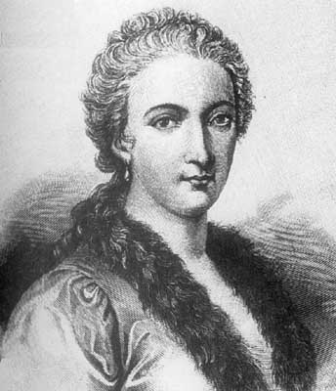
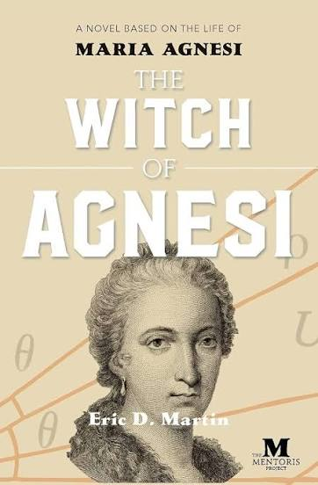
How one word made Maria Agnesi a "witch"
RULE 2 · TRANSLATE EXACTLY
MILAN, 1748
LONDON, 1801
TODAY
She wrote Instituzioni analitiche, a calculus textbook.
Written in Leibniz's notation.
The curve: la versiera, from vertere, "to turn".
John Colson translated it in English.
Read the curve as avversiera: she-devil.
Calls it "the Witch".
Uses Newton's notation in his translation.
Still "the Witch" — even on a novel's cover
Maria Gaetana Agnesi (1718–1799)
One misread word decided how a woman mathematician has been remembered for two centuries.
Read more: Wikipedia · MacTutor · 1748 and 1801 editions: Linda Hall Library. Portrait: engraving, via Wikipedia.
Notes:
[Norberto]. The curve had been studied by Fermat and by Guido Grandi, who named it versiera in 1718. Colson (Lucasian Professor at Cambridge) learned Italian to translate Agnesi; his translation was published posthumously in 1801. Accounts differ slightly on exactly how the error happened (misreading versiera as avversiera, or knowing that versiera could also mean she-devil) — a nice small example of competing secondary explanations. Exercise: compare the two scans yourself. Also note Colson replaced Leibniz's notation with Newton's — the translation changed the mathematics' presentation, not just a name.

Slide 7
Who solved the inverse problem first?
RULE 3 · DO THE MATHEMATICS
THE INVERSE PROBLEM EXAMPLE
A coin of unknown bias θ lands heads 7 times in 10 tosses. How likely is it that θ lies between 0.5 and 0.9?
APPROACH 1 · BERNOULLI 1713, DE MOIVRE 1738
APPROACH 2 · BAYES 1763
Bernoulli's law of large numbers:
if θ is known, the share of heads x̄ₙ gets close to θ as number
of trials → ∞
So estimate θ by the sample proportion: θ ≈ x̄ = 7/10
De Moivre's normal approximation: x̄ scatters around θ with s.d. √(θ(1−θ)/n) ≈ √(0.7 × 0.3 / 10) = √0.021 ≈ 0.14, using our guess θ ≈ 0.7
Bernoulli's law and De Moivre's approximation both describe the data given θ, and become exact only as n → ∞
Prior: before tossing, every θ in [0, 1] is equally likely
Weigh each θ by how well it explains the data: θ⁷(1−θ)³
Rescale to total 1: ∫₀¹ θ⁷(1−θ)³ dθ = 1/1320, so the curve for θ is 1320 θ⁷(1−θ)³
Take the area from 0.5 to 0.9 under that curve
P(0.5 < θ < 0.9 | 7 heads in 10) ≈ 0.87 — an exact probability for θ after just 10 tosses
θ ≈ 0.7 — but can't say how likely 0.5 < θ < 0.9 is
Why: the prior treats θ as uncertain, so θ itself can carry a probability — updated by the data.
Why: θ is one fixed, unknown number — not random. Probabilities apply only to the data (the tosses).
The dispute: De Moivre (1756): Approach 1 is enough. Price (1763): no one before Bayes. Price was right.
Bayes, Essay, Phil. Trans. 53 (1763) · Diniz & Bellhouse, Mr. Bayes and the classics: a suggested interpretation (2022)
Notes:
[Ivelina]. Start with the example: a coin of unknown bias, seven heads in ten tosses. What's the chance its true probability of heads is between 0.5 and 0.9? That's the inverse problem (Hartley's name for it, 1749). The direct problem goes the other way: θ = ½ is known and you predict the data. Bayes's wording: 'Given the number of times in which an unknown event has happened and failed: Required the chance that the probability of its happening in a single trial lies somewhere between any two degrees of probability that can be named.' Left column: Bernoulli's law of large numbers is about the frequency when θ is known; run backwards it gives a point guess θ ≈ 0.7. De Moivre's normal approximation says how much the frequency wobbles around θ (s.d. ≈ 0.14 at θ = 0.7, n = 10) — still about the data given θ, exact only as n grows. Right column: Bayes treats θ as uncertain, starts from a flat prior (his billiard table), weights each θ by the likelihood θ⁷(1−θ)³, and divides by the normalising integral, the Beta function B(8, 4) = 1/1320. The result is a Beta(8, 4) curve for θ, mean 2/3; the area between 0.5 and 0.9 is 0.868 — a direct answer at n = 10. The dispute: the 1756 edition of De Moivre (perhaps written by its editor Patrick Murdoch, per Diniz & Bellhouse) implies Approach 1 is enough; Price says no one before Bayes had solved it. The calculation shows they answer different questions, so Price was right. Note the denominator: here it has a closed form; in general it doesn't — the 'intractable denominator' of our Bayes chapter. Optional: 70 heads in 100 gives P(0.6 < θ < 0.8) ≈ 0.97.

Slide 8
Was Bayes's essay written to answer Hume on miracles?
RULE 4 · KEEP THE UNCERTAINTY
For — Stigler (2013)
Against — Diniz & Bellhouse (2022)
1764 offprints carry Price's own title: "A Method of Calculating the Exact Probability of All Conclusions founded on Induction"
Price openly used Bayes against Hume in Four Dissertations (1767)
Verdict: Price "almost surely", Bayes "not improbably"
Nowhere in his writings does Bayes look for applications
His route runs through De Moivre's Doctrine of Chances (1738)
Hume's essay appeared April 1748; Hartley's book, citing an "ingenious Friend's" solution, went to press December 1748 — little time
Stigler himself calls Bayes's motive the most speculative step: the essay never mentions Hume, and most of Bayes's notes are lost.
Stigler, Statistical Science 28 (2013) 283–288 · Stigler, Statistical Science 33 (2018) 117–125 · Diniz & Bellhouse, arXiv:2202.03819
Notes:
19:00–23:00 [Ivelina]. The two papers are open access — students can read both this week. Stigler found offprints of Bayes's essay and Price's supplement with titles far bolder than the journal's 'An Essay towards solving a Problem in the Doctrine of Chances'. He argues Price chose them, and that Price was almost surely, and Bayes not improbably, aiming at Hume's 'Of Miracles' (1748). Diniz and Bellhouse argue the opposite for Bayes: his work came from De Moivre, and if Bayes is Hartley's 'ingenious Friend' (Hartley 1749), the chronology leaves at most about eight months after Hume. Note that both camps agree Price used Bayes against Hume; they disagree about Bayes. Ask: what evidence would settle it? (A dated note in Bayes's hand mentioning Hume would.)

Slide 9
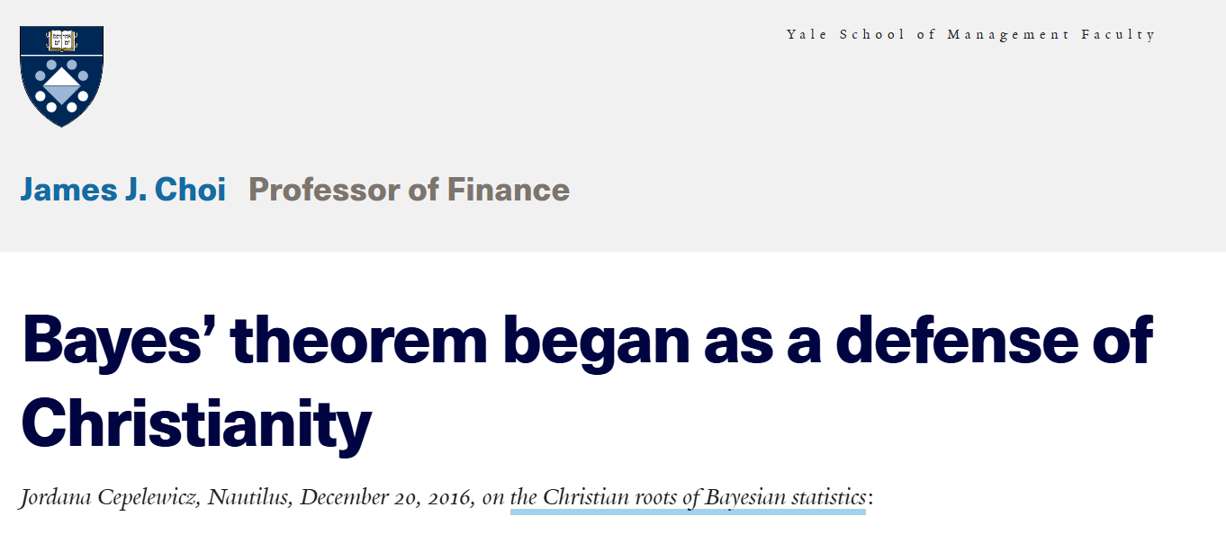
How an open debate becomes a "fact"
RULE 4 · KEEP THE UNCERTAINTY
PRIMARY · 1764
The essay title chosen by Price. It says nothing about Bayes's motive.
SECONDARY · 2013
Stigler: Price almost surely, Bayes "not improbably" — and Bayes's motive is the most speculative step.
Shared under the headline "Bayes' theorem began as a defense of Christianity". Now the theorem itself has a motive — no source says so.
POPULAR · YALE BLOG
Your job: trace the claim back to the original, note who says what and how confidently, and set the rival interpretations side by side.
J. Cepelewicz, Nautilus, 20 Dec 2016 · reposted on J. J. Choi's Yale SOM faculty page. Ask an AI chatbot the same question and compare.
Notes:
23:00–25:00 [Ivelina]. This is the module's thesis in one slide. Each step away from the original strips qualifications. Primary: a title, chosen by Price, silent on Bayes's motive. Secondary: Stigler's careful 'almost surely' for Price and 'not improbably' for Bayes, with his own warning that Bayes's motive is the most speculative step. Popular: 'inspired to prove Hume wrong' — the qualifier is gone. Repost: a Yale faculty blog shares the Nautilus piece under the headline 'Bayes' theorem began as a defense of Christianity' — now it's no longer about Bayes's or Price's motives but about the origin of the theorem itself, which no source supports (and Diniz & Bellhouse argue Bayes came to the problem through De Moivre). Note the extra authority effect: a university domain makes the claim look more reliable, but it is a blog repost of a magazine article. Nobody lied; the qualifying words just did not survive compression. Live demo option: ask ChatGPT or Claude 'Why did Bayes write his essay?' and see which layer the answer resembles.

Slide 10
The "impartial" verdict on who invented calculus
RULE 5 · ASK WHO WROTE IT, AND WHY
Newton
Leibniz
Method of fluxions, c. 1665–66
Shared in manuscript (De analysi, 1669); published only in 1704 and 1711
Dot notation: ẋ
Differential calculus, c. 1675
First in print: Acta Eruditorum, 1684
Notation dx and ∫ — the one we still use
THE VERDICT · ROYAL SOCIETY, 1712
The Commercium Epistolicum backs Newton and implies Leibniz copied him
But Newton was the Society's President: he drafted the report himself and reviewed it anonymously
Today historians agree: independent discovery
Newton Papers, Cambridge Digital Library (MS Add. 3968) · The Newton Project, Oxford · Booklet Ch. 6.6, p. 57
Notes:
[Norberto]. Two people, two routes to the same result. Newton developed fluxions in 1665–66 but kept them largely in manuscript (De analysi went to John Collins in 1669; the method appeared in print only in 1704 with the Opticks, and De analysi in 1711). Leibniz worked out his differential calculus around 1675 and published first, in Acta Eruditorum in 1684, with the dx and ∫ notation we still use. When Leibniz appealed to the Royal Society in 1711–12, its committee report, the Commercium Epistolicum, sided with Newton and implied plagiarism. The manuscripts in Cambridge (MS Add. 3968) show Newton, the Society's President, chose the material and drafted the report himself; he then reviewed it anonymously in Philosophical Transactions (1715; 1714 in England's old calendar). The 'official' verdict was repeated in Britain for over a century, until Leibniz's own papers were published. Lesson: always ask who wrote a source and why. Optional bridge to the Bayes chapter: in 1736 Thomas Bayes anonymously defended Newton's fluxions against Berkeley's The Analyst (1734). Booklet Chapter 6, section 6.6, p. 57.

Slide 11
The quarrel that built modern statistics
RULE 6 · EXPECT TO DISAGREE
Who, when | What they built | Position on priors
Fisher, 1922–1925 | Maximum likelihood, sufficiency, Fisher information | Rejected them
Neyman & E. Pearson, 1928–33 | Tests as decisions: error rates, power | No prior at all
Ramsey (1926/31), de Finetti (1930s) | Probability as coherent belief; exchangeability | Personal priors
Jeffreys, 1939–1946 | Invariant prior from Fisher's own information; the K ratio | Objective priors
Wald, 1947–1950 | Complete class theorem: admissible rules are Bayes rules | Minimax preferred
Savage, 1954 | Subjective expected utility: a single axiomatic theory | Personal priors
Each theorem was a move in an argument. Read the papers and you hear the argument; read a textbook and you get only the theorems.
Notes:
16:00–19:00 [Ivelina]. From our Bayes chapter. The 'frequentist vs Bayesian' quarrel was not a distraction from mathematics; it produced it. Fisher built information and likelihood partly to avoid priors; Jeffreys then turned Fisher's information into a prior (1946) — Fisher's machinery powering a method he opposed. Wald, preferring minimax, proved that every admissible rule is (a limit of) a Bayes rule. Point out a dating subtlety: Ramsey wrote 'Truth and Probability' in 1926 but it was published posthumously in 1931 — written date vs published date is exactly the kind of thing a summary gets wrong.

Slide 12
Who is missing from the story — and why?
RULE 7 · LOOK FOR WHO IS MISSING
Madhava & the Kerala school
Maria Gaetana Agnesi
Dorothy Wrinch
c. 1350–1530 · power series for sine, cosine and arctangent, centuries before Europe
1748 · a major calculus textbook; remembered mainly through a mistranslation
1919–1923 · co-wrote the papers Jeffreys credited as the basis of Scientific Inference
Elizabeth L. Scott
Joan Clarke
Arianna Rosenbluth
1948 · the Neyman–Scott problem: maximum likelihood can be inconsistent
1939–45 · Banburist with Turing; deputy head of Hut 8; Cambridge then denied women full degrees
1953 · wrote the first implementation of the Metropolis (MCMC) algorithm on MANIAC
But stay with the evidence: credit what documents show — a co-authored paper, an acknowledgement, a job title — not what someone "must have" done.
Notes:
47:00–50:00 [Ivelina / Norberto]. Discrimination by gender, nationality and language shaped who got credit and whose texts got translated. Kerala work was in Sanskrit and Malayalam and reached European historians late; Agnesi is known for a 'witch'; Wrinch's collaboration with Jeffreys is acknowledged in his own words yet rarely mentioned; Scott's name is in the 'Neyman–Scott problem' but she is often omitted; Clarke's statistical contribution is less documented than Turing's or Good's. The search itself is an exercise in primary sources: author lists, acknowledgements, archives, minutes. But be disciplined: claim only what the documents support.

Slide 13
When the rules were broken
SECTION 2 · WHY WE NEED THE ORIGINAL SOURCES
Four cases: law, consulting, medicine, pharmaceutical research.
Fabrication
Distortion
The cited source does not exist.
The source exists — but says something else.
Notes:
28:00–29:00 [Norberto]. Transition. The habits we're asking for are not academic fussiness: professionals who skipped them have been sanctioned, refunded fees, retracted papers, and in one case contributed to a public-health crisis. Two failure modes to watch for: fabrication (often, now, from generative AI) and distortion (people citing a real source for something it doesn't say — the older and arguably more dangerous problem, and exactly the Stigler-hedge mechanism).

Slide 14
Mata v. Avianca
LAW · NEW YORK, 2023 · FABRICATION
A personal-injury lawyer used ChatGPT for legal research
His brief cited court decisions that did not exist, e.g. "Varghese v. China Southern Airlines"
They came with invented quotations and citations
Outcome: $5,000 sanctions, and letters to the real judges named as authors of the fake opinions
HOW HE "CHECKED"
He asked ChatGPT whether Varghese was a real case.
It said yes — available in reputable legal databases.
Mata v. Avianca, Inc., 678 F. Supp. 3d 443 (S.D.N.Y. 2023), Opinion and Order on Sanctions, 22 June 2023 · Wikipedia summary
Notes:
29:00–31:00 [Norberto]. The famous first case. The lawyer had practised for thirty years. The key lesson for students: you cannot verify a source by asking the system that produced it. Verification means opening the actual source — here a legal database; for us, the Royal Society archive or a library. Also note: the sanctions were partly for continuing to stand by the fake opinions after their existence was questioned.

Slide 15
The Deloitte welfare report
CONSULTING & GOVERNMENT · AUSTRALIA, 2025 · FABRICATION
A 237-page review of the IT system behind automated welfare penalties, commissioned by the Australian government.
CONTRACT VALUE
A$440k
A University of Sydney researcher, Chris Rudge, found references to academic papers that do not exist and a fabricated quotation from a Federal Court judgment.
The findings may stand — but one fake quotation put the whole report in doubt.
The revised report disclosed the use of Azure OpenAI; Deloitte agreed to repay part of its fee.
Associated Press, 7 October 2025, "Deloitte to partially refund Australian government for report with apparent AI-generated errors" · also in U.S. News
Notes:
33:00–35:00 [Norberto]. A professional services firm, a government client, a large fee. The department said the substance of the report was unchanged after corrections — but that is exactly the point: once a reader finds one invented citation, every other claim needs re-checking. Misquoting a judge is the legal-world equivalent of misquoting Bayes or Newton. Deloitte did not confirm to AP whether the errors came from AI, but the revised version disclosed Azure OpenAI use.

Slide 16
A real source, misread 608 times
MEDICINE · 1980–2017 · DISTORTION
The source: Porter & Jick, "Addiction Rare in Patients Treated with Narcotics", a five-sentence letter to the New England Journal of Medicine (1980)
What it said: 4 cases of addiction among about 12,000 hospital inpatients given narcotics
How it was cited: as proof that long-term opioid therapy rarely causes addiction
608
72%
81%
times other papers cited this 101-word letter, 1980–2017
cited it as evidence that addiction was rare
did not mention the patients were in hospital
NEJM now prints an editor's note on the letter: it has been "heavily and uncritically cited".
Porter & Jick, NEJM 302 (1980) 123 (original letter) · Wikipedia · Leung, Macdonald, Stanbrook, Dhalla & Juurlink, NEJM 376 (2017) 2194–2195
Notes:
37:00–40:00 [Norberto]. The most important case, because nothing was fabricated. The source was real and short enough to read in thirty seconds. Hundreds of authors cited it for a claim it never made — that long-term outpatient opioid therapy is safe — because they were citing other citations rather than the letter. The 2017 analysis argues this citation pattern helped shape the narrative that reassured prescribers. Connect back: this is the same mechanism as 'not improbably' becoming 'inspired to prove Hume wrong'. Only reading the original catches it. (Check the NEJM volume/page numbers on the footer against the journal before presenting.)

Slide 17
The Surgisphere retractions
PHARMACEUTICAL RESEARCH · 2020 · UNVERIFIED DATA
The claim: a Lancet paper (22 May 2020) said hydroxychloroquine raised the risk of death in COVID-19 patients
The data: records said to come from over 600 hospitals, via a private company, Surgisphere
The impact: the WHO paused the drug's arm of its trial
The collapse: auditors asked for the raw data; the company refused. Within two weeks the paper — and a companion NEJM paper — were retracted
THE LESSON
Co-authors had put their names to data they had never seen.
Their retraction: they could no longer "vouch for the veracity of the primary data sources".
Retraction notices: The Lancet and NEJM, 4 June 2020 · NCBI research news · Piller, Science 371 (2021) 331
Notes:
40:00–41:30 [Norberto]. Pharma example. Not an AI case — a primary-data case. The analysis may have been competent, but nobody outside the company had seen the underlying records. For historians the analogue is quoting a 'manuscript' you've only seen described, or a 'letter' known from a biography. If you haven't seen it, say so.

Slide 18
Which rule did each case break?
SECTION 2 · THE COMMON THREAD
Case | Rule broken | What would have caught it
Mata v. Avianca | 8 · Verify every reference | Looking the case up in a legal database
Deloitte report | 8 · Verify every reference | Opening every reference and the judgment quoted
Porter & Jick | 1 · Study the originals | Reading the 101-word letter itself
Surgisphere | 1 · Study the originals | Seeing the raw records before signing
Bayes and Hume | 4 · Keep the uncertainty | Reading Stigler's own caveat — and Bayes's essay
Open the original. Every time.
Notes:
[Norberto]. Summarise quickly — the table maps each case to a rule from Section 1. The last row is ours: the history of mathematics has exactly the same failure modes, just with lower stakes than a court or a hospital.

Slide 19
Where to start
SECTION 3
Step 1 Read the histories of mathematics and of statistics.
Step 2 Follow their footnotes to the originals — and check them yourself.
Step 3 Be ready to disagree with the authors you started from.
Notes:
[Ivelina]. Section 3: a practical path. Good secondary histories are where you start, not where you stop.

Slide 20
Start with these histories — then go past them
SECTION 3 · STEP 1
History of mathematics
Calculus
History of statistics
J. Stedall, The History of Mathematics: A Very Short Introduction (OUP, 2012)
C. B. Boyer, The History of the Calculus and Its Conceptual Development (1949; Dover)
S. M. Stigler, The History of Statistics (Harvard, 1986)
J. Stedall, Mathematics Emerging: A Sourcebook 1540–1900 (OUP, 2008)
V. J. Katz, "Ideas of Calculus in Islam and India", Mathematics Magazine 68 (1995)
I. Hacking, The Emergence of Probability (1975); L. Daston, Classical Probability in the Enlightenment (1988)
V. J. Katz, A History of Mathematics: An Introduction (3rd ed., 2009)
J. Stillwell, Mathematics and Its History (Springer)
A. I. Dale, A History of Inverse Probability; Most Honourable Remembrance (2003)
J. Fauvel & J. Gray (eds), The History of Mathematics: A Reader (1987)
D. R. Bellhouse, "The Reverend Thomas Bayes", Statistical Science 19 (2004)
Notes:
[Ivelina]. Serious, well-sourced starting points — not the last word. Stedall's short book is the ideal first read: it is explicitly about how history of mathematics is done, and her sourcebook puts facsimiles and translations of originals in your hands. Use these to find the primary sources, then read those — and feel free to end up disagreeing with the authors, as Diniz and Bellhouse disagree with Stigler.

Slide 21
Verify at the source: where the originals live
SECTION 3 · STEP 2 · FREE ONLINE
Archive | What you'll find | Link
Royal Society Publishing | Phil. Trans. from 1665, incl. Bayes's Essay (1763) | doi.org/10.1098/rstl.1763.0053
The Newton Project | Newton's writings, incl. the priority dispute | newtonproject.ox.ac.uk
Cambridge Digital Library | Scans of Newton's manuscripts | cudl.lib.cam.ac.uk
Euclid's Elements (D. E. Joyce) | The full Elements, after Heath | mathcs.clarku.edu/~djoyce
The Euler Archive | Euler's works, with translations | scholarlycommons.pacific.edu/euler
Internet Archive · Gallica | Early printed books (Hartley, De Moivre, Laplace) | archive.org · gallica.bnf.fr
Project Euclid · arXiv | Stigler (2013, 2018); Diniz & Bellhouse (2022) | projecteuclid.org · arxiv.org
MacTutor (St Andrews) | Biographies with references to the sources | mathshistory.st-andrews.ac.uk
Notes:
[Ivelina]. Almost everything discussed today can be read free, tonight. The links are clickable in the shared deck. Library access adds JSTOR and journal archives. Agnesi's 1748 and 1801 editions are in the Linda Hall Library's digital collections (lindahall.org).

Slide 22
Writing it carefully
SECTION 4
Let's play a game.
Notes:
[Ivelina]. Section 4: from reading to writing. Eight writing habits, one sentence written three ways, then the careful-sentence game.

Slide 23
Eight habits for writing history carefully
SECTION 4 · WHEN YOU WRITE
1 Quote only what you have read — with edition and page.
5 Check every reference resolves: DOI, archive, folio.
2 Translate exactly; give the original word when it matters (versiera, sēmeion, fluxion).
6 Do the mathematics yourself before you explain it.
7 Name whom you disagree with, and on what evidence.
3 Label fact, inference and speculation — and keep your sources' "probably".
8 Use AI to find things, never as a source.
Verify every claim at the original.
4 Date precisely: written vs published; Old vs New Style calendars.
Notes:
[Ivelina]. Walk through, with an example for each: (1) quote Bayes from the Phil. Trans. text, not from a website; (2) versiera, sēmeion; (3) Stigler's 'not improbably'; (4) Ramsey 1926/1931; the Commercium 'Account' dated 1714 in England's Julian calendar but 1715 on the Continent; (5) every DOI should open; (6) you can't judge Bayes vs De Moivre without the mathematics; (7) e.g. 'We follow Diniz & Bellhouse against Stigler on Bayes's motive, because…'; (8) AI tools are useful for finding where to look and for translation drafts — but every fact and every reference must be checked at its source, and you are responsible for what you submit. Then straight into the careful-sentence game.

Slide 24
What a careful sentence looks like
SECTION 4 · ONE SENTENCE, THREE WAYS
Weak
Bayes developed his theorem to disprove Hume's argument against miracles.
Better
Some historians believe Bayes was responding to Hume.
Careful
Stigler (2013) argues from the 1764 offprint titles that Price almost surely, and Bayes "not improbably", had Hume's "Of Miracles" (1748) in view. Diniz and Bellhouse (2022) reject this for Bayes on chronological grounds. The published essay never mentions Hume or miracles; only Price's introduction mentions God, in support of the argument from design.
Notes:
46:00–47:00 [Ivelina]. The weak version states speculation as fact. The 'better' version is vague — which historians, on what evidence? The careful version names the scholars, the evidence, the strength of each claim, the counter-argument, and what the primary source does and doesn't say. It's longer — that's the price of accuracy.

Slide 25
The careful-sentence game
SECTION 4 · A GAME
1 Read the sentence on the slide.
2 Call out what's wrong — or say "nothing".
POSSIBLE PROBLEMS
Distorted source
"Probably" turned into "definitely"
Mistranslation
Wrong date or wrong name
Biased source taken at face value
Someone left out
Nothing wrong at all
3 Name the rule it breaks.
4 Rewrite it carefully. Then we reveal ours.
Notes:
[Ivelina]. Four rounds (a spare fifth round is in the appendix), about a minute each. Split the room into teams if you like: a point for spotting the problem, a point for naming the rule, a point for the best rewrite. On each round slide, click once in Present mode to reveal the answer.

Slide 26
THE CAREFUL-SENTENCE GAME · ROUND 1 OF 4
"Agnesi studied a curve she called the Witch."
What's wrong with it? Which rule does it break? How would you write it?
MISTRANSLATION · RULE 2
Agnesi never called it a witch; the name comes from an English translation.
Careful: "Agnesi (1748) called the curve la versiera; John Colson's 1801 English translation rendered it 'the Witch'."
Notes:
[Ivelina]. Click to reveal.

Slide 27
THE CAREFUL-SENTENCE GAME · ROUND 2 OF 4
"Jeffreys introduced the Bayes factor in 1935."
What's wrong with it? Which rule does it break? How would you write it?
WRONG NAME · RULE 1
The idea is Jeffreys's; the name is not. His own papers call it K.
Careful: "From 1935 Jeffreys compared hypotheses with a ratio he called K; the term 'Bayes factor' was coined by I. J. Good in 1958."
Notes:
[Ivelina]. Click to reveal. Good credited both Jeffreys and Turing, who had called it 'the factor'.

Slide 28
THE CAREFUL-SENTENCE GAME · ROUND 3 OF 4
"Richard Price used Bayes's results against Hume's argument on miracles in his Four Dissertations (1767)."
What's wrong with it? Which rule does it break? How would you write it?
NOTHING WRONG · RULE 8 KEPT
It's in Price's own book, and Stigler and Diniz & Bellhouse both accept it.
The dispute is about Bayes's motive, not Price's. Careful writing knows which claim is which.
Notes:
[Ivelina]. The trick round. Click to reveal. Contrast with the 'weak' sentence earlier: the evidence is documented for Price, speculative for Bayes.

Slide 29
THE CAREFUL-SENTENCE GAME · ROUND 4 OF 4
"Newton invented calculus, and Leibniz copied him."
What's wrong with it? Which rule does it break? How would you write it?
BIASED SOURCE TAKEN AT FACE VALUE · RULE 5
It repeats the Royal Society's 1712 verdict — which Newton drafted himself.
Careful: "Newton and Leibniz developed calculus independently; the 1712 report accusing Leibniz of plagiarism was drafted by Newton."
Notes:
[Ivelina]. Click to reveal. Link back to the Rule 5 slide (Commercium Epistolicum).

Slide 30
A little bit about me
NORBERTO LUCERO AZUARA
I studied Mathematics and Physics in Mexico.
I finished my PhD in Mathematics at QMUL.
My research uses stochastic processes: calculus, probability, and random motion.
My research connects to the final part of the booklet's calculus chapter: Modern Calculus and Randomness.
In the booklet, I contributed to:
Chapter 2, The Pythagoras Theorem
Chapter 5, Algorithms for Solving Algebraic Equations
Chapter 6, Calculus: A Global History of Change, Motion, and the Infinite
Notes:
[Norberto]. Brief introduction.

Slide 31
Aim of the session
SECTION 5 · CALCULUS
We will test some common claims about calculus.
CLAIM TO INVESTIGATE
“Newton invented calculus, and Leibniz copied him.”
By the end, we should be able to explain why this sentence is historically too simple.
Notes:
[Norberto]. Picks up straight from the last game round: the same sentence, now taken apart properly.

Slide 32
For each claim
SECTION 5 · CALCULUS
FOR EACH CLAIM:
Decide: true, false, or misleading?
Identify what mathematical idea is involved.
Ask: who or what disappears if we say it too quickly?
Mathematics
→
History
→
Credit
Notes:
[Norberto]. The method for the next slides.

Slide 33
Claim 1: “Newton invented calculus alone”
SECTION 5 · CALCULUS
Newton invented calculus alone.
What is true?
What is missing?
Newton created a powerful systematic calculus.
His language of fluents and fluxions suited motion and mechanics.
Exhaustion and approximation.
Tangent and quadrature problems.
Infinitesimals and indivisibles.
Infinite series and algebraic methods.
ẋ(t) = dx/dt, ẍ(t) = d²x/dt²
Notes:
[Norberto]. Claim 1.

Slide 34
Activity: build the background
SECTION 5 · CALCULUS
Pair task, 3 minutes: choose one ingredient below and explain how it prepares the way for calculus.
Exhaustion: polygons approach a circle
Indivisibles: area as slices
Tangents: instantaneous direction
Series: infinite algebraic processes
Which ingredient feels most like calculus? Which one feels least like calculus? Why?
Notes:
[Norberto]. 3-minute pair task.

Slide 35
Claim 2: “Leibniz copied Newton”
SECTION 5 · CALCULUS
Leibniz copied Newton.
Newton's emphasis
Leibniz's emphasis
Motion through time.
Rates as fluxions.
Strong link with mechanics.
Relationships between variables.
Differentials and sums.
Notation that travelled well.
ẋ, ẍ
dx, dy, dy/dx, ∫
The priority dispute matters historically, but the deeper story is about publication, notation, institutions, and communication.
Notes:
[Norberto]. Claim 2. Links back to the Newton–Leibniz slide in Section 1.

Slide 36
Discussion: what counts as invention?
SECTION 5 · CALCULUS
SMALL GROUP DISCUSSION · 4 MINUTES
If two mathematicians independently organise similar ideas differently, what should count as “inventing” a subject?
Discovery | Publication | Influence
Who had the idea? | Who made it public? | Whose notation and methods spread?
Credit in mathematics is not always a single-person answer.
Notes:
[Norberto]. 4-minute group discussion.

Slide 37
Claim 3: “Calculus is a purely European story”
SECTION 5 · CALCULUS
Calculus is a purely European story.
Greek
exhaustion
Chinese
approximations
Islamic
sums and geometry
Indian
series
→
→
→
A careful statement: Newton and Leibniz produced systematic calculi in seventeenth-century Europe, but many earlier cultures worked on calculus-like problems.
Notes:
[Norberto]. Claim 3.

Slide 38
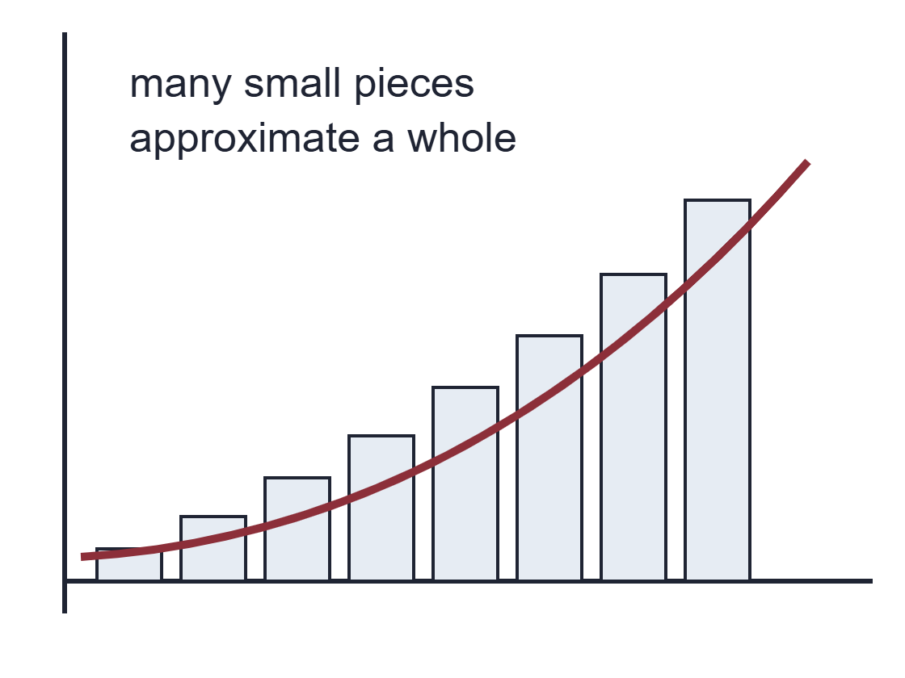
Case study: sums and areas
SECTION 5 · CALCULUS
A historical bridge
Sums of powers appear in problems about areas and volumes:
1ᵏ + 2ᵏ + ⋯ + nᵏ
Ibn al-Haytham's work on sums belongs to the prehistory of integral calculus.
Notes:
[Norberto]. Case study: sums of powers.

Slide 39
Case study: infinite series in India
SECTION 5 · CALCULUS
Madhava and the Kerala school
A modern way to write one related result is:
arctan(x) = x − x³/3 + x⁵/5 − x⁷/7 + ⋯
This is not Newton–Leibniz calculus, but it is part of the longer history of infinite processes.
Notes:
[Norberto]. Case study: Madhava series.

Slide 40
Claim 4: “Women were absent from calculus”
SECTION 5 · CALCULUS
Women were absent from calculus.
Agnesi | organised and taught calculus through a major textbook.
Somerville | communicated mathematical physics and continental analysis.
Germain | applied calculus and differential equations to elasticity.
Mathematical contribution can mean discovery, but also teaching, exposition, translation, circulation, and application.
Notes:
[Norberto]. Claim 4. Agnesi links back to the 'Witch' slide in Section 1.

Slide 41
The Fundamental Theorem as a historical bridge
SECTION 5 · CALCULUS
F(x) = ∫ₐˣ f(t) dt ⟹ F′(x) = f(x)
OLD PROBLEM 1
OLD PROBLEM 2
Find the slope of a curve at one point.
Find the area accumulated under a curve.
The theorem is powerful because it connects two traditions: tangents and quadrature.
Notes:
[Norberto]. The FTC as the link between the two old problems.

Slide 42
Calculus did not stop there: Itô and randomness
SECTION 5 · CALCULUS
Classical calculus often assumes smooth paths. But Brownian motion and noisy systems are irregular. Itô calculus studies equations such as:
Calculus keeps changing when new mathematical problems appear.
dXₜ = μ(Xₜ, t) dt + σ(Xₜ, t) dWₜ
One new rule is:
(dWₜ)² = dt
Notes:
[Norberto]. Norberto's own research area: stochastic calculus.

Slide 43
Main activity: rewrite the myth
SECTION 5 · CALCULUS
GROUP TASK · 5 MINUTES
Rewrite this sentence so that it is mathematically and historically more accurate:
“Newton invented calculus, and Leibniz copied him.”
Your sentence should mention at least two of the following:
earlier mathematical background;
Newton and Leibniz's different approaches;
notation, publication, or institutions;
global and inclusive contributions.
Notes:
[Norberto]. 5-minute group task.

Slide 44
Possible rewrite
SECTION 5 · CALCULUS
Newton and Leibniz independently developed systematic versions of calculus in the seventeenth century. Their work was revolutionary, but it built on earlier problems about areas, tangents, motion, infinitesimals, and infinite series. Leibniz's notation helped calculus spread, while Newton's approach was deeply connected to mechanics. A fuller history also includes contributions from Greek, Chinese, Islamic, Indian, European, women, and modern global mathematicians.
What would you change in this rewrite? Is it still too long? Too cautious? Too modern?
Notes:
[Norberto]. Compare with the groups' rewrites.

Slide 45
What to take away
SECTION 5 · CALCULUS
Calculus is a mathematical theory of change and accumulation.
Newton and Leibniz matter, but they are not the whole story.
Notation and publication affect who gets remembered.
Inclusive history is not decoration: it changes the structure of the story.
Modern calculus continues the same questions in new settings.
Calculus is a shared human history of change.
Notes:
[Norberto]. Wrap-up, then hand back for the close.

Slide 46
Thank you
HISTORY OF MATHS · MTH6003U
Questions?
Ivelina Mladenova & Norberto Lucero Azuara · Queen Mary University of London
Notes:
[Ivelina and Norberto]. Thank the students and take questions. Remind them the booklet is linked from the QR code on the first slide.

Slide 47
APPENDIX · EXTRA ROUND FOR THE CAREFUL-SENTENCE GAME
"Jeffreys worked out the foundations of Scientific Inference (1931) on his own."
What's wrong with it? Which rule does it break? How would you write it?
SOMEONE LEFT OUT · RULE 7
Jeffreys himself credited his joint papers with Dorothy Wrinch.
Careful: "Jeffreys credited his papers with Dorothy Wrinch (1919–1923) as the basis of Scientific Inference (1931)."
Notes:
[Ivelina]. Appendix: spare round, use only if there is time. Click to reveal.

